Slide 1
What Makes a Reward Model a Good Teacher?
Haisem Naeem 21L-7528
Abdullah Zia 21L-7519
Abdul Moiz 21L-1861

Slide 2
1
Table of Contents
2
3
4
5
6
7
Introduction to RLHF
Problem with Accuracy-Centric Evaluation
Reward Variance: The Missing Ingredient
Theoretical Insights
Experimental Validation
Implications for Reward Model Design
Conclusion & Future Work

Slide 3
Reinforcement Learning from Human Feedback (RLHF)
Two-Step Process:
Reward Model Training: Learns from human preferences (e.g., Bradley-Terry model).
Policy Optimization: Language model (policy) maximizes reward via methods like PPO/RLOO.
Key Assumption: Higher reward model scores → Better alignment with human preferences.

Slide 4
The Accuracy Paradox
Current Practice: Reward models are evaluated by accuracy (agreement with human rankings).
Problem:
High accuracy ≠ Better policy performance.
Example: A "boring teacher" gives all students similar grades → No clear learning signal.
Key Insight: Reward variance (separation between scores) is critical for optimization.

Slide 5

Reward Variance Defined
Variance Formula:
Intuition:
High variance = Clear distinction between good/bad outputs.
Low variance = Flat optimization landscape → Slow learning.

Slide 6
Theoretical Insights
Theorem 1:
Low reward variance → Slow optimization (time to improve scales as Ω(Var^−1/3))
Theorem 2:
Perfectly accurate reward models can underperform less accurate ones with higher variance.
Theorem 3:
Reward models are policy-dependent (no universal "best" model)

Slide 7
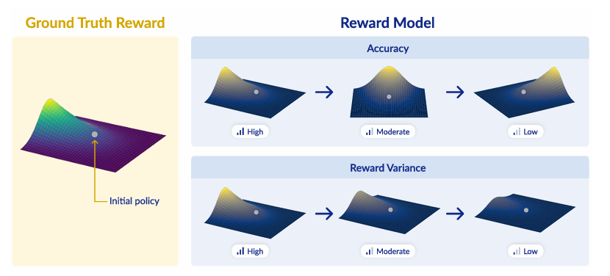
Flat vs. Varied Landscapes
Notes:
Visual: Compare flat terrain (low variance) vs. mountainous terrain (high variance).
Flat: No gradient signal → Policy "walks in place."
Varied: Steep gradients → Faster convergence.
Takeaway: Accuracy aligns with ground truth, but variance drives optimization speed.

Slide 8
Experimental Setup
Datasets: UltraFeedback (human preferences), AlpacaFarm.
Models: Pythia (1B/2.8B), Llama-3.2B.
Reward Models:
Trained on 0%–100% on-policy data (inducing varying reward variance)
Normalized for fair comparison
Policy Optimization: RLOO (simpler alternative to PPO)

Slide 9
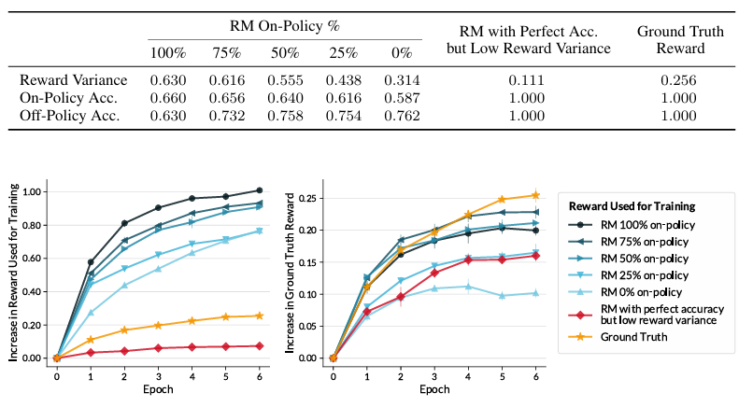
Results
Notes:
Key Findings:
High Variance → Faster Learning: Models with 100% on-policy data outperform low-variance models.
Perfect Accuracy ≠ Success: A perfectly accurate but low-variance model underperforms.
KL Efficiency: Accurate models preserve policy capabilities better.

Slide 10
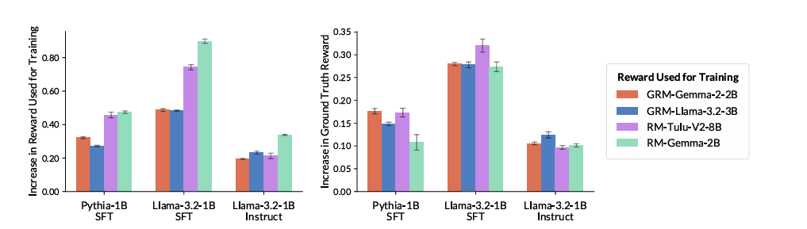
Policy-Specific Reward Models
Notes:
No single reward model works best for all LMs
The reward model which works best of Pythia might not be good for Llama and vice versa.

Slide 11
Implications for Reward Model Design
Beyond Accuracy: Optimize for variance during training (e.g., margin-based losses)
Policy-Aware Evaluation: Test reward models on the target policy’s outputs
Avoid Over-Regularization: Balance KL penalties to allow exploration
Notes:
2.1 Beyond Accuracy: Optimize for Variance
Why variance matters: Even a perfectly accurate model can induce low variance in predicted rewards (i.e., it gives almost the same score to all likely outputs), leading to vanishing gradients and a “flat” RLHF objective landscape (Theorem 1)
Some forms of accuracy even show negative correlation with learning. Hence focusing solely on accuracy can be bad
2.2 Policy-Aware Evaluation
On-policy vs off-policy accuracy: Traditional benchmarks measure accuracy on fixed (“off-policy”) outputs, but those outputs may differ from what your model actually generates during Reinforcement Learning from Human Feedback (RLHF).
2.3 Avoid Over-Regularization
KL penalty in RLHF: The objective maximizes EₓEy∼πθ[rRM(x,y)] − λ·KL(πθ‖π_ref) where λ controls how much the policy can diverge from its pretrained start.
Trade-off: If λ is too large, the policy can’t explore high-variance regions—again flattening the landscape. Balance λ to allow enough exploration while preserving pretrained capabilities

Slide 12
Limitations & Future Work
Open Questions:
How to design reward models that naturally induce high variance?
Role of variance in alternative methods (e.g., Best-of-N, contrastive learning)
Broader Impact: Rethinking benchmarks to include variance and policy compatibility
Notes:
Q#1:
Train on on‐policy samples.
Adaptive reward scaling with caution. (multiplying all rewards raises variance by c2c^2c2, also amplifies noise and can destabilize gradient estimates)
Q#2:
Contrastive learning objectives. (maximize separation between “positive” (preferred) and “negative” (less preferred), correlates with higher reward variance)
Best-of-N sampling. (In the Best-of-N paradigm, at each step you score NNN candidates and pick the top one. Here, accuracy alone suffices)

Slide 13
Conclusion
Key Message:
Accuracy + Variance > Accuracy Alone
A reward model must be both correct and informative
Call to Action: Move beyond accuracy-centric evaluation in RLHF
Notes:
Accuracy + Variance > Accuracy Alone. A reward model must be correct (rank well) and informative (spread out its scores) to be an effective teacher.
Call to Action: Move beyond accuracy-centric evaluation in RLHF:
Incorporate reward variance into both training and benchmarks.
Always test on on-policy outputs.
Tune KL regularization to preserve exploration.

